Slide 1
2015/16
Financial Meeting
2015 Parent Survey Funding Priorities
2015/2016 Financial Recap
Curriculum Investment
2016/17 Proposed Budget
Fundraising Goals
Mentor Program
Upcoming Events

Slide 2
2015 Survey Funding Priorities

Slide 3
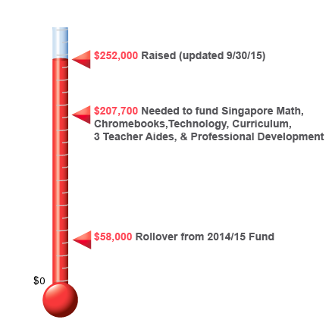
2015/16 Direct Giving Participation
Participation Rates
By School Year:
2013/14 61 %
2014/15 46 %
2015/16 65+ %
Notes:
3

Slide 4
2015/16 Anticipated Income vs. Expenses
As of September 30, 2015
Funds Raised as of 09/30/15 (Income of $276,000 less Fundraising Expenses of $24,000) |  |  | ($252,000)
Anticipated Expenses for 2015/2016
Mandarin Curriculum | Curriculum Developer/Coordinator | $100,000 | $120,000
 | Curriculum Materials | $20,000
Instructional Assistants | 3 Assistants at $13,000/year |  | $39,000
Singapore Math | Materials | $27,000 | $4,000
 | Teacher Training & Subs | $4,000
 | CUSD Math Rebate | ($27,000)
Professional Development | Teacher conferences and training |  | $9,000
Technology | 33 Chromebooks + Cart | $10,500 | $12,800
 | 2 Document Cameras | $1,200
 | Teacher Training & Subs | $1,100
Library | Mandarin Language Books |  | $1,000
Operational Expenses | Financial fees, website, etc |  | $9,500
TOTAL |  |  | $195,300
Anticipated Variance for 2015/2016 |  |  | ($56,700)

Slide 5
Mandarin Curriculum
What are we doing for 2015/2016?
Hire Part-Time Consultant/Consultants to help assess existing curriculum and determine where deficiencies are and how to improve them
MC Barrosa 1 day/week
3 Lead Teachers
Stipend for Teachers willing to create curriculum outside of class time
MIPAC is working with Administration Staff and Teachers to determine what areas a Consultant or Consultants would be most useful so we can proceed with interviewing and hiring.
Options for 2016/2017?
MIPAC will evaluate how current system is working throughout the school year and will report their findings to Friends of MIP. As the year progresses they will determine if we should continue with the same system or vet out other options.

Slide 6
2016/17 Proposed Budget
As of October 6, 2015

Slide 7
2016/17 Fundraising Goals
Direct Giving – 100% Participation
Less then $80 per month or $3 per day!
61% participation in 2013, 46% in 2014, and over 65% in 2015
Additional Ways to Participate
Volunteer time and goods at our fundraisers throughout the year
Volunteer services such as grant writing, public relations, etc.
What will we have to cut if we don’t reach our fundraising goal?
Reduced investment in Mandarin Curriculum
Fewer Instructional Assistants
Less Program Support

Slide 8
Mentor Program
"Coming together is a beginning. Keeping together is progress. Working together is success." ~Henry Ford
Vision: To establish a culture to nourish a sense of community, relationship, and ownership by setting examples for our children through participation and accountability
Mission: To develop a parent network to unify and strengthen the Mandarin Immersion Program
Objectives:
•Community outreach
•Fortify parent network
•Resources for parents
•Bridge board and community
Framework: •Mentor:Mentee relationship
Allows for networking within this unique program and community through direct relationships; information and guidance to facilitate ease of navigation into the program and classroom.
•Parent Handbook for the school year
Introduction to the MIP, Boards, and Foundations; important events and meetings calendar; resources and directories; FAQs; and more...
Notes:
8

Slide 9
News & Events
Upcoming events
Mom’s Night Out October 23
Dads of MIP November 5
Welcome Playdate (Cancelled)
MIP Coffee Talk October 29 @ 9am
FofMIP Board Meeting November 3 @ 6pm
Annual Gala March 5, 2016
Volunteer Opportunities
http://www.signupgenius.com/go/20f0a4ea4ad29a2ff2-committee
Enrollment Committee, Mentor Program Committee, Social Committee, MIP Class Reps (A. Chang & Koch need 2; Loh, Lee, C. Chang need 1)

